Slide 1
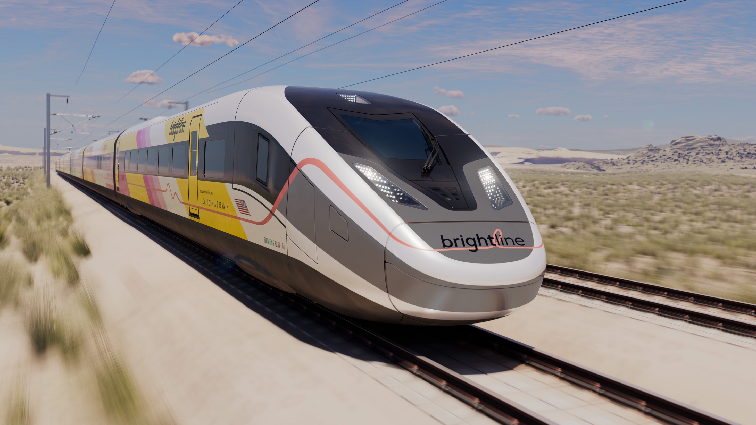
BRIGHTLINE WEST
UPDATE
Nevada Transportation Conference
May 13, 2025

Slide 2


Slide 3

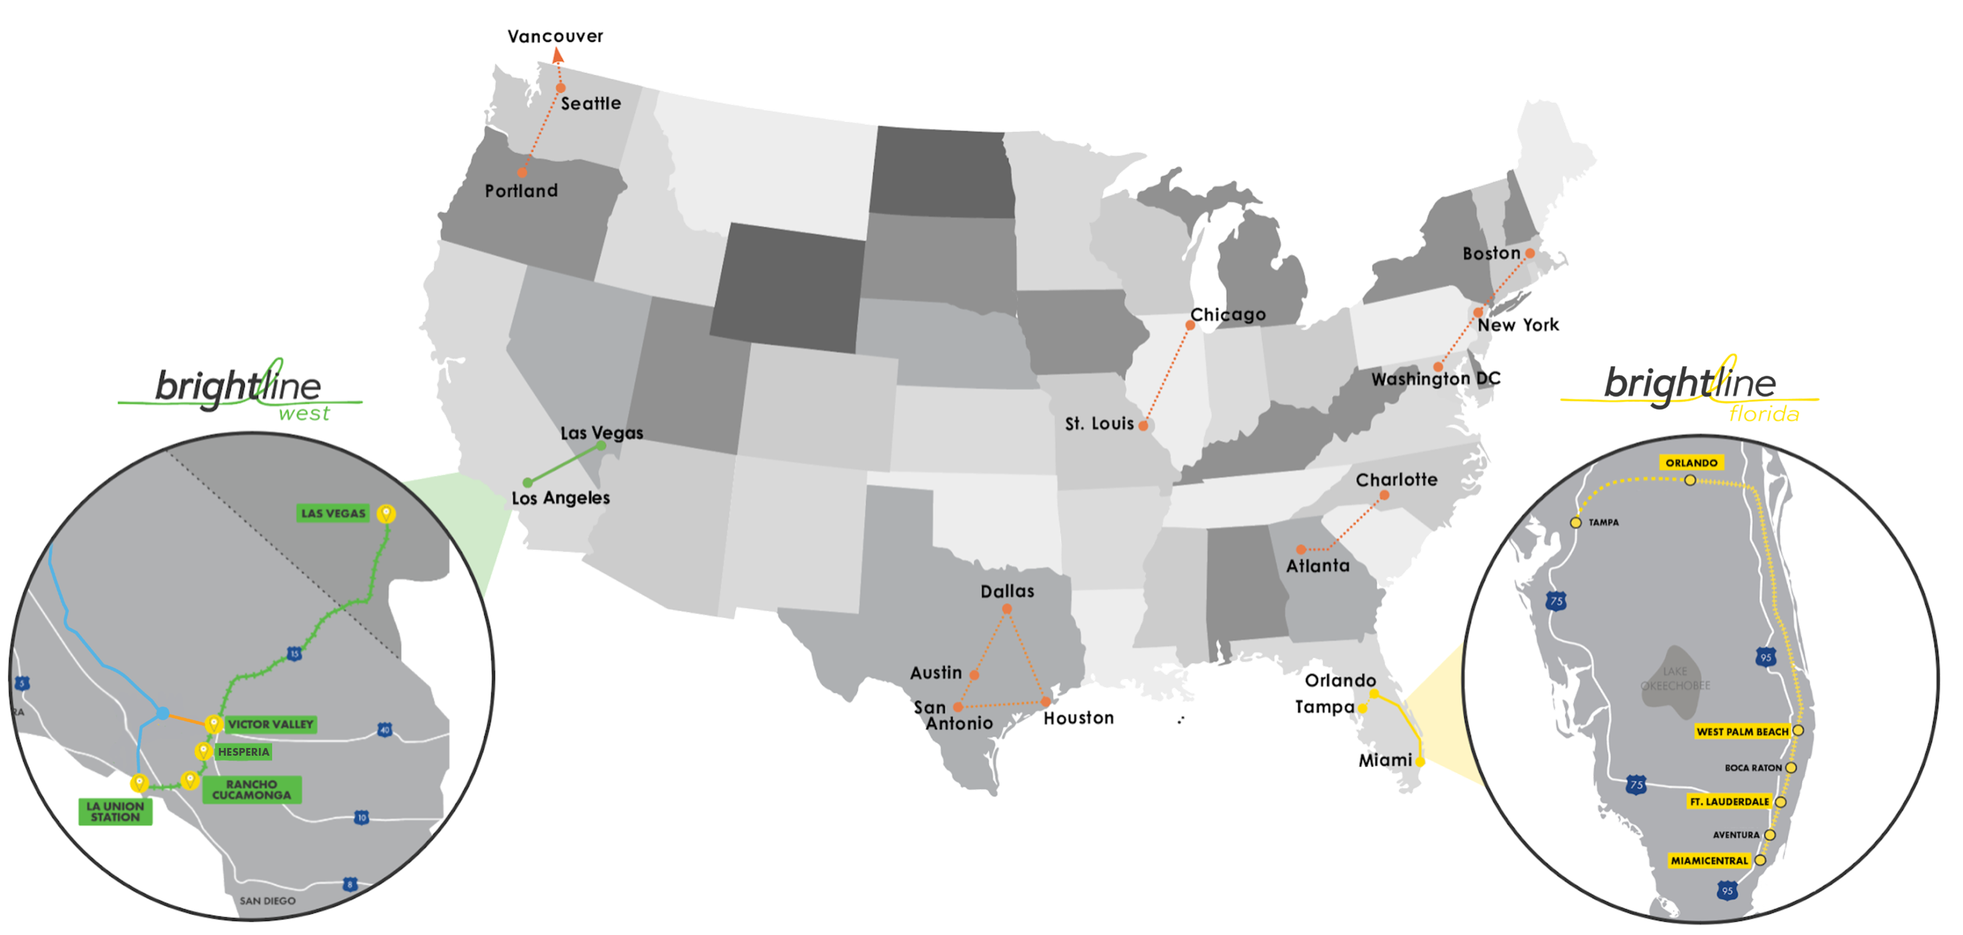
COMPANY GOAL IS TO CONNECT CITY PAIRS THAT ARE
“TOO LONG TO DRIVE
AND TOO SHORT TO FLY”

Slide 4
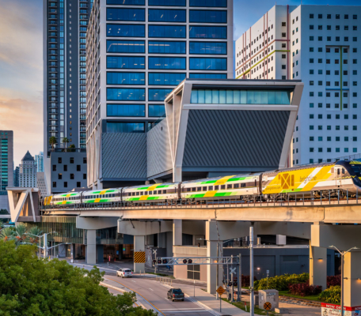
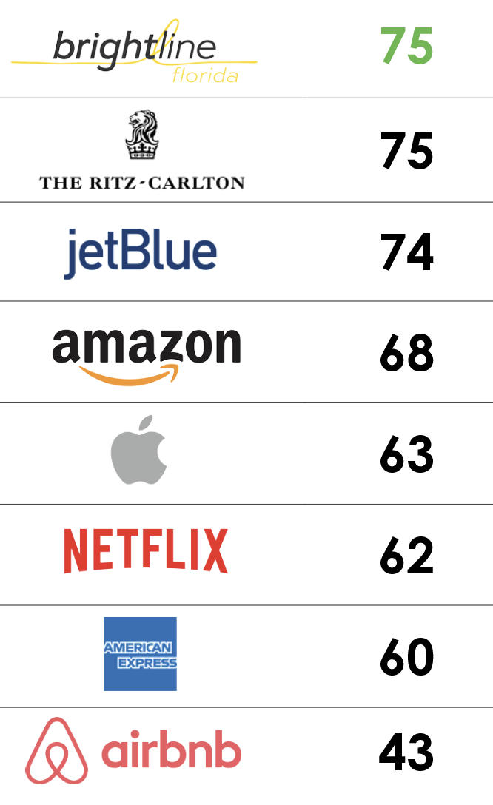
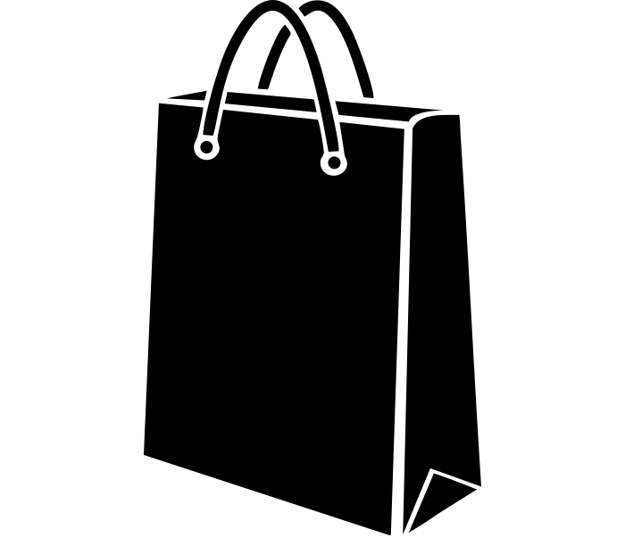
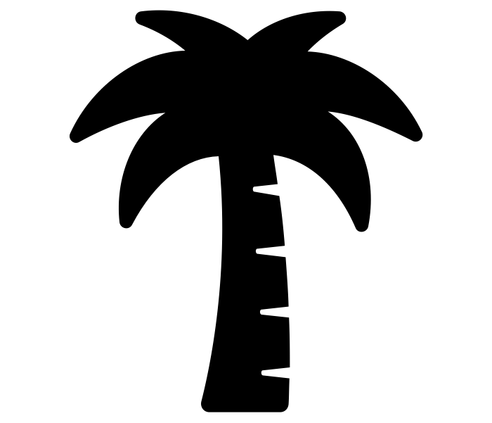



BRIGHTLINE FLORIDA
Our First Passenger System
Brightline opened in 2018, with stations in Miami, Fort Lauderdale, and West Palm Beach
Infill stations opened in Aventura and Boca Raton in December 2022
Expansion to a flagship station in Orlando was launched in 2023
Reimagined train travel to be more hospitality focused, driving wide customer satisfaction
Our presence has re-energized neighborhoods, through transit oriented-development
KEY DOWNTOWN LOCATIONS
CURRENT STATIONS
LEAD CUSTOMER SATISFACTION
MIAMICENTRAL
AVENTURA
FORT LAUDERDALE
BOCA RATON
ORLANDO
Miami Central features office, residential and retail

Slide 5
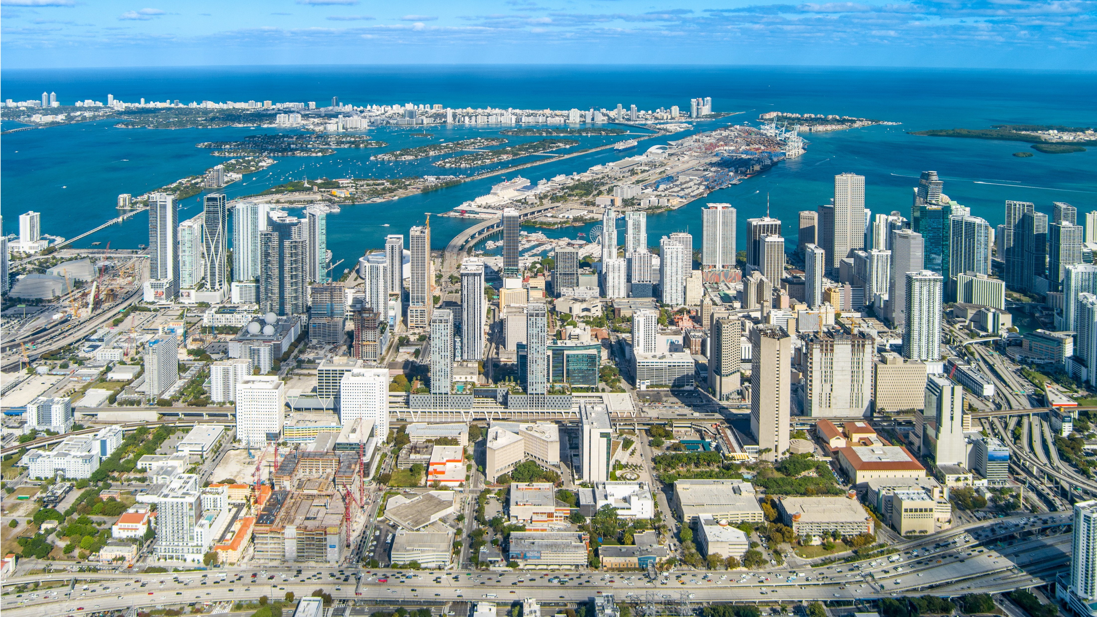
What We’re
Building Next

Slide 6
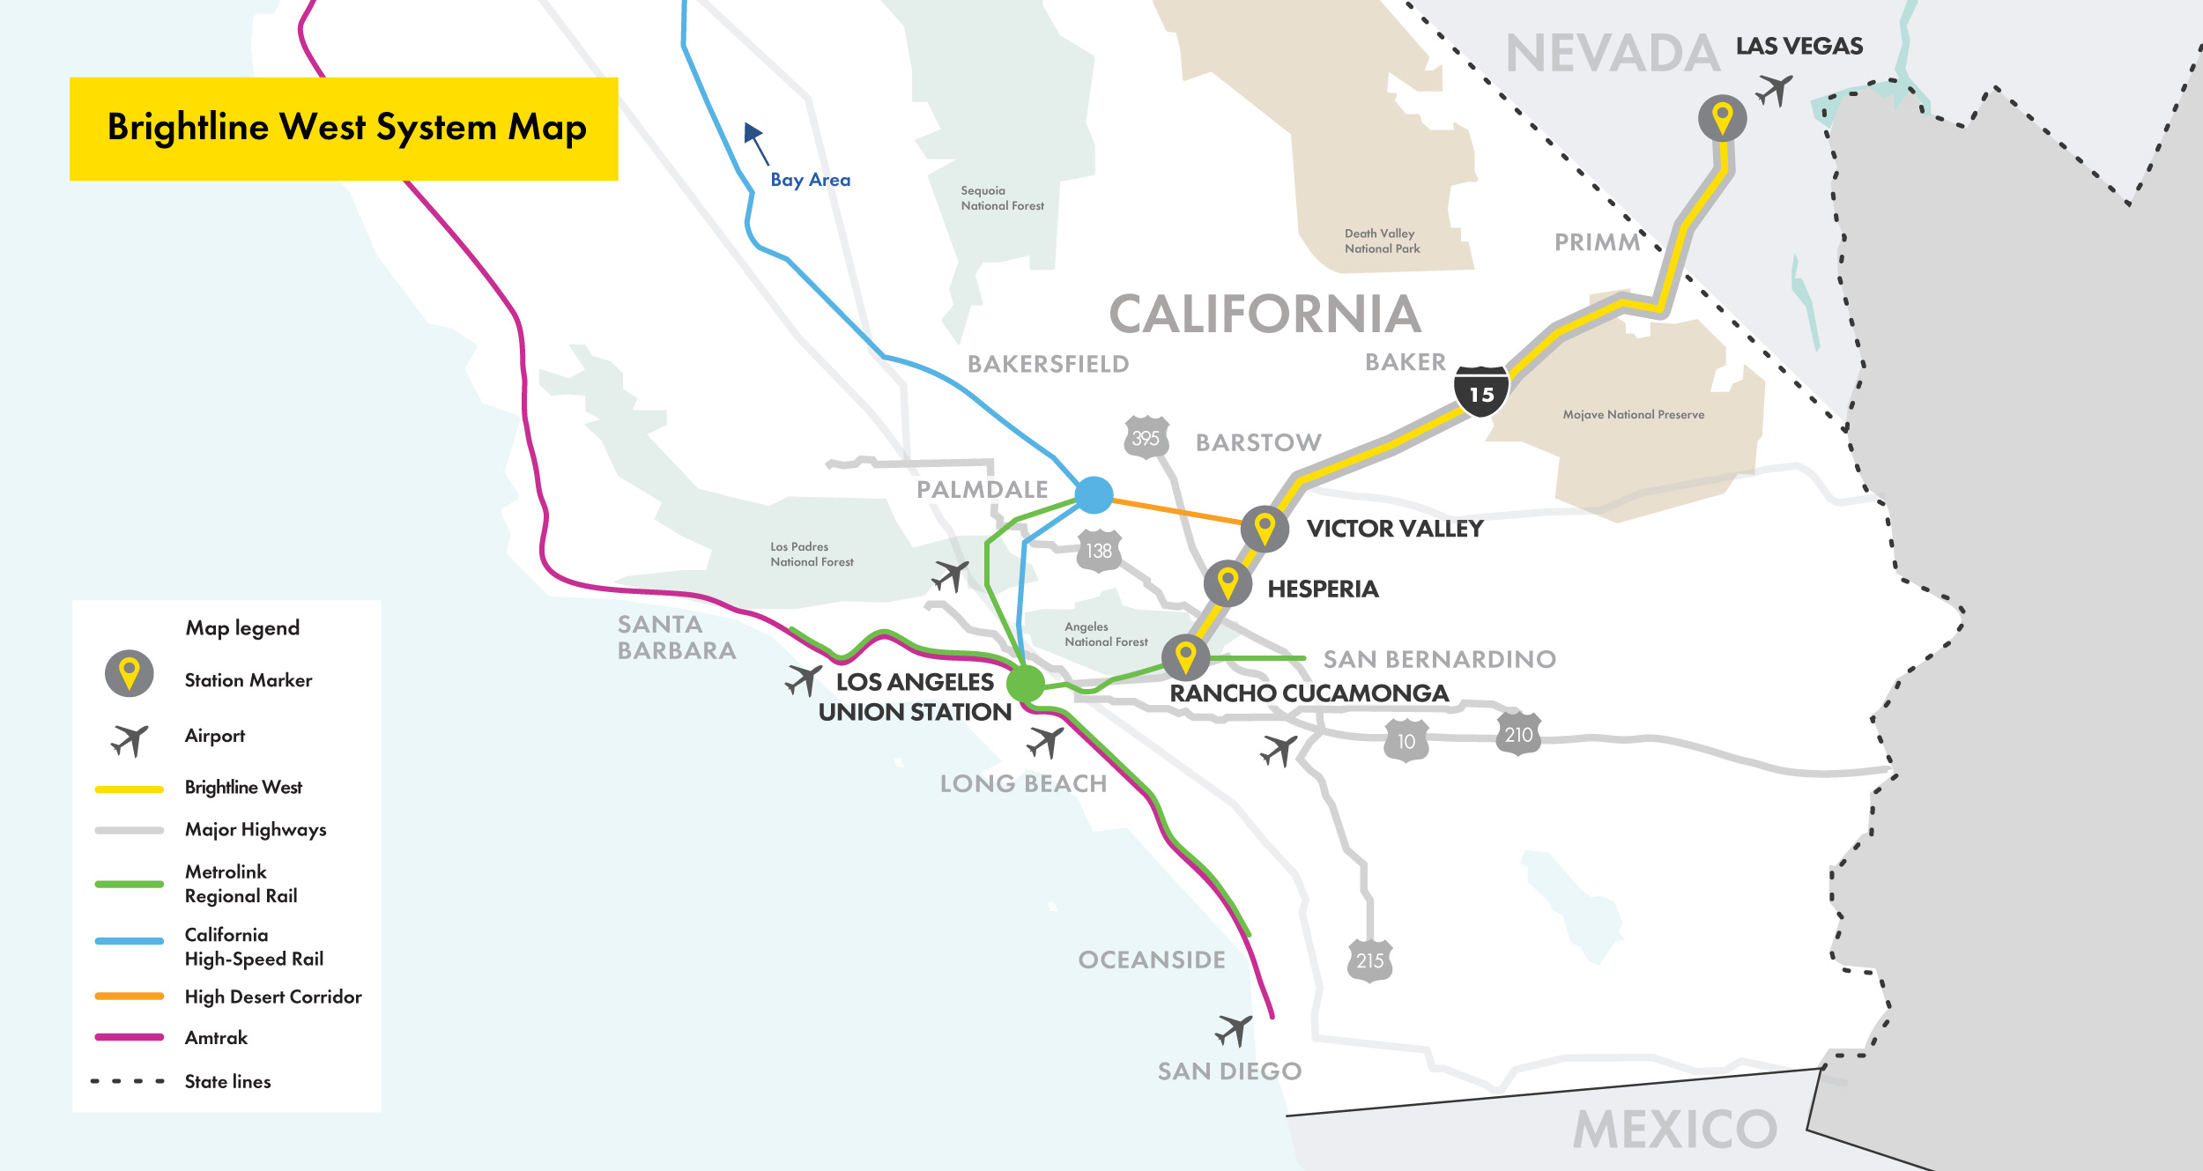
BRIGHTLINE WEST Connecting
Las Vegas and Southern
California
All-electric trains
in a protected corridor with zero
at-grade crossings
218-mile trip
Las Vegas to Rancho
Cucamonga
Up to 186 mph
true high-speed rail
+11 million
one-way pass/year

Slide 7
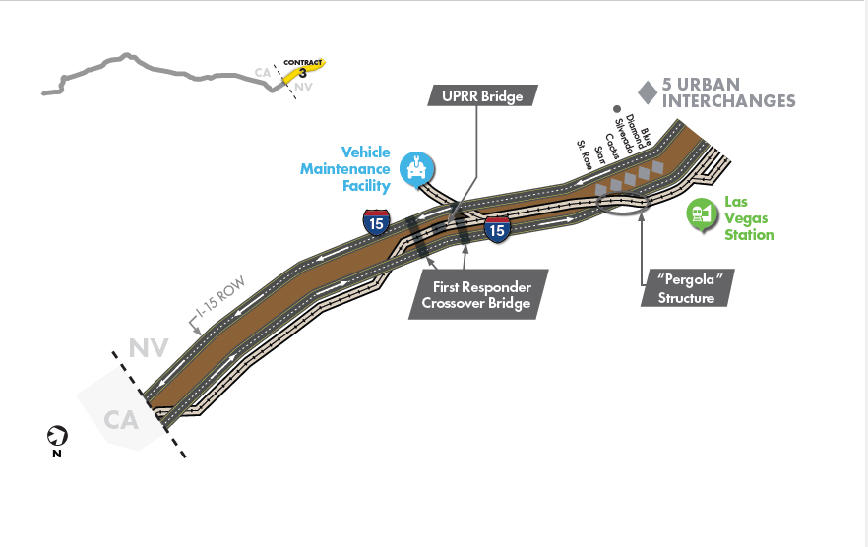
Rail Alignment
In California, primarily median running. In Nevada:
East-side running for North Segment – 7 miles
Median running for Middle Segment – 6 miles
Side running from MP2 to MP 16 from State line

Slide 8
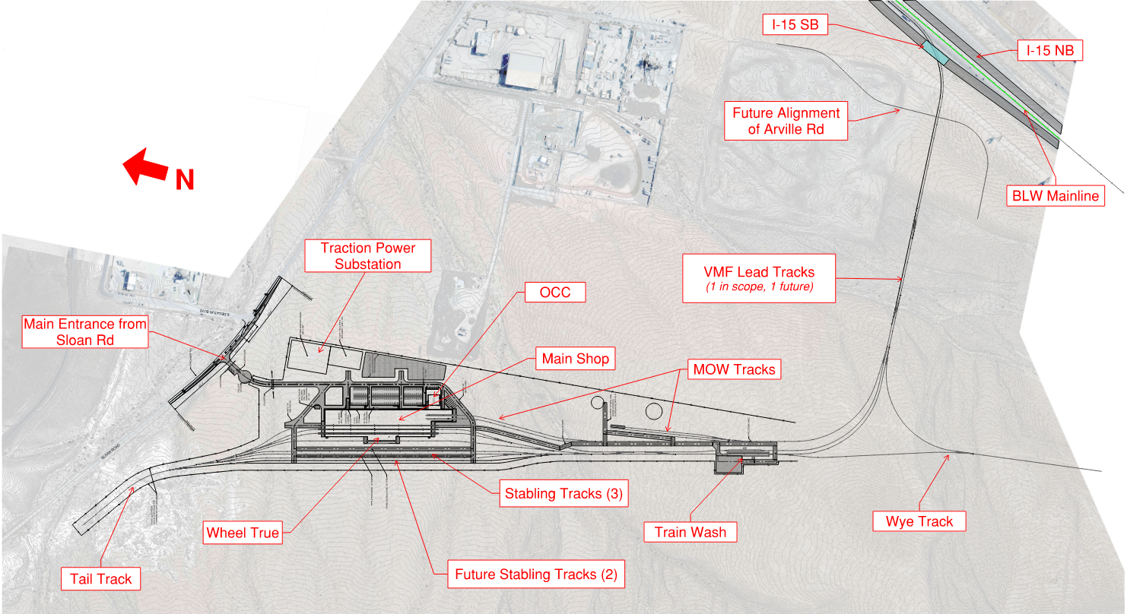
Planned Maintenance Facility (Depot) Site

Slide 9
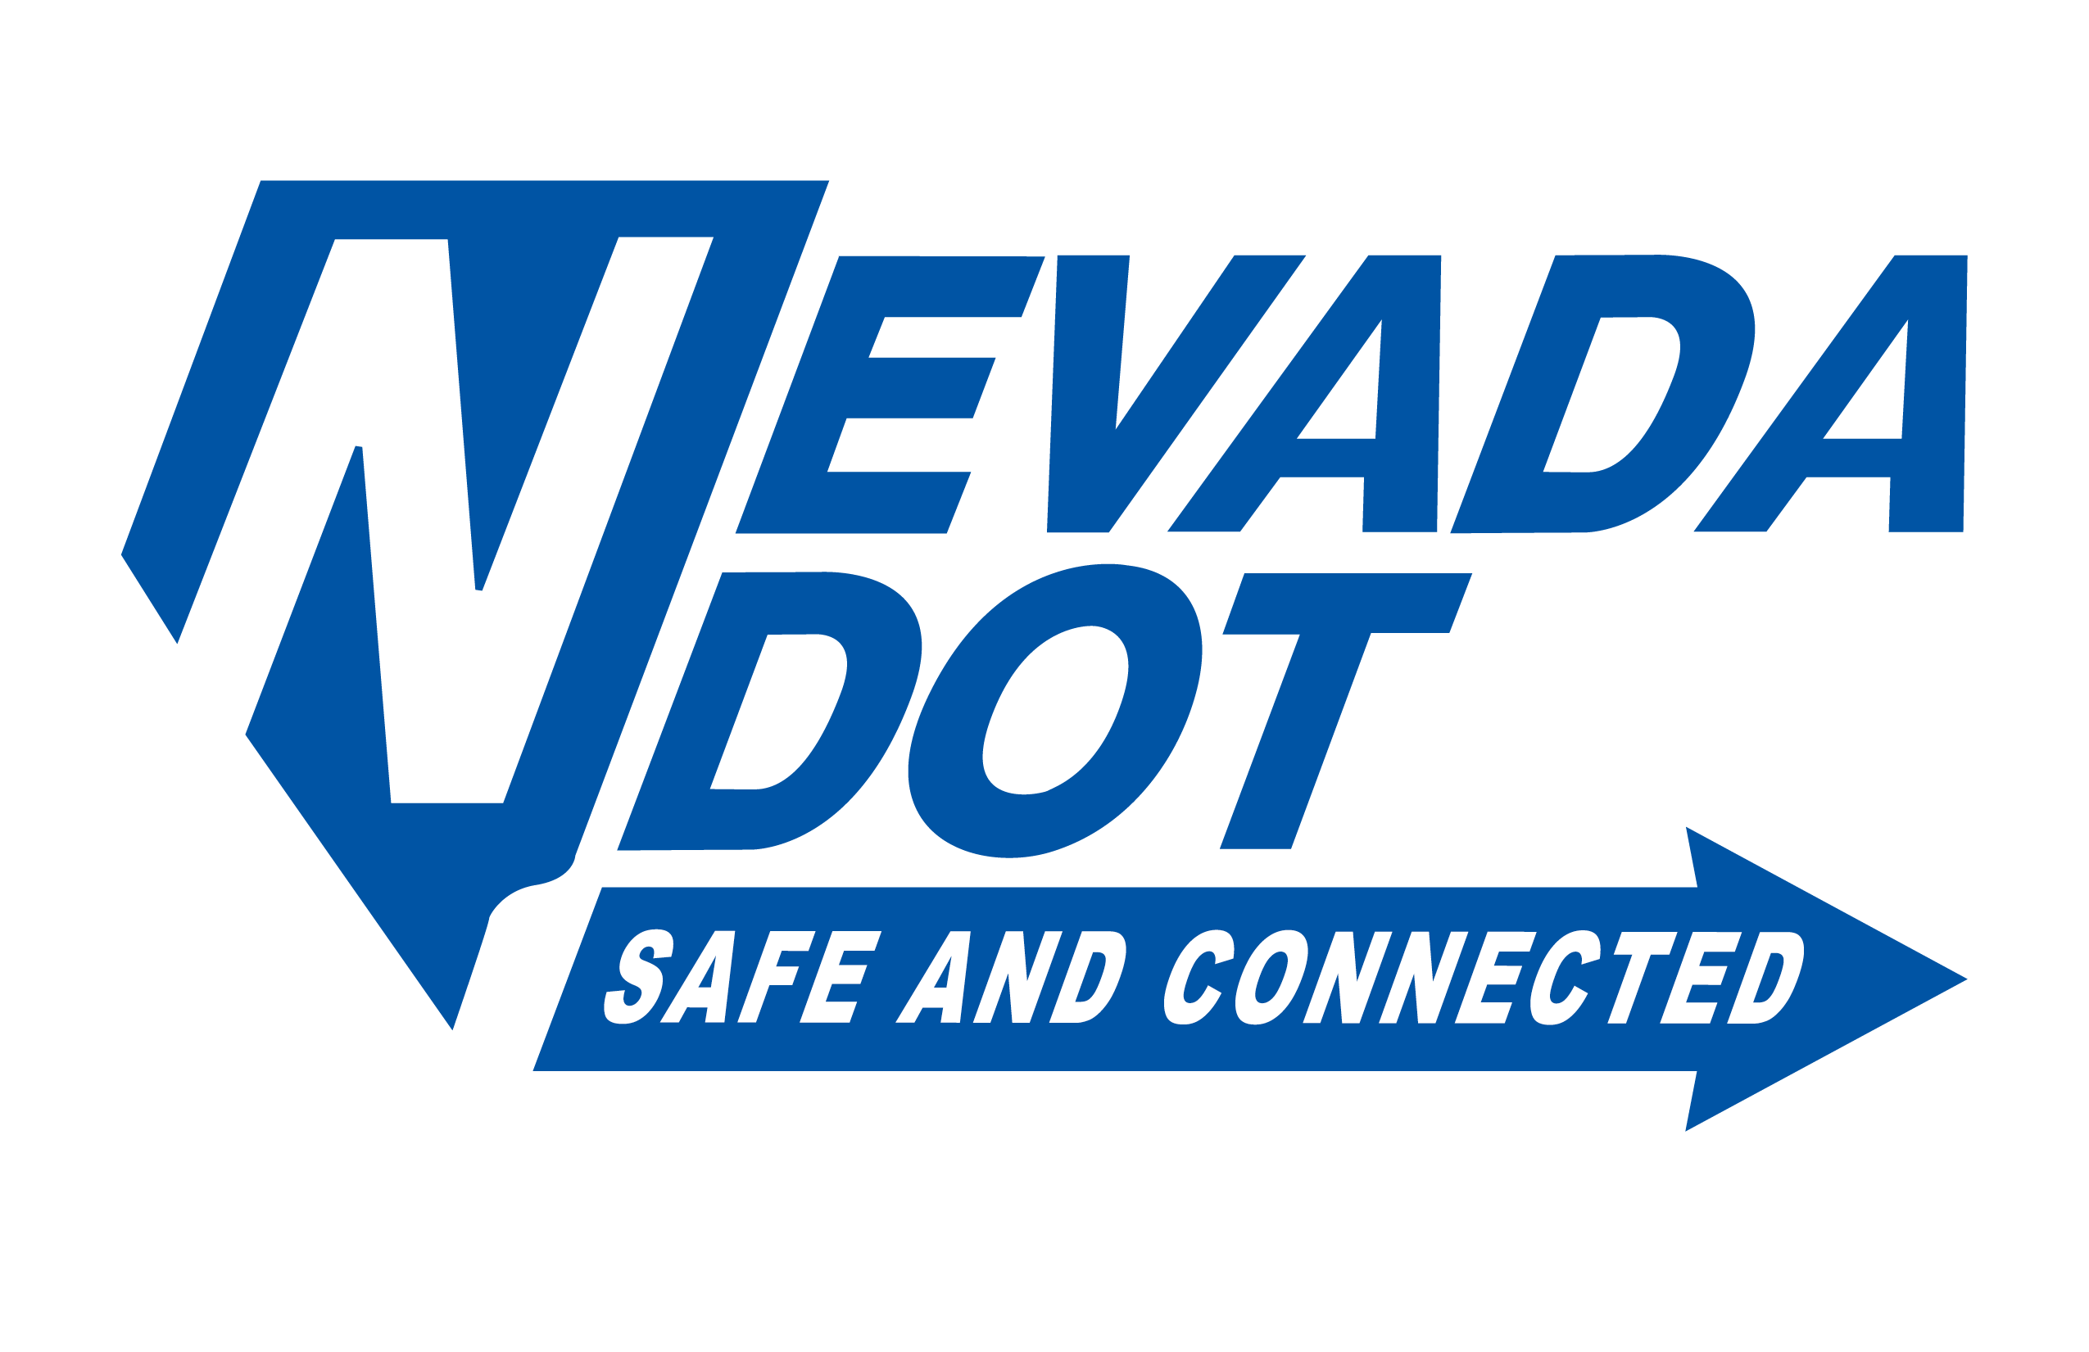
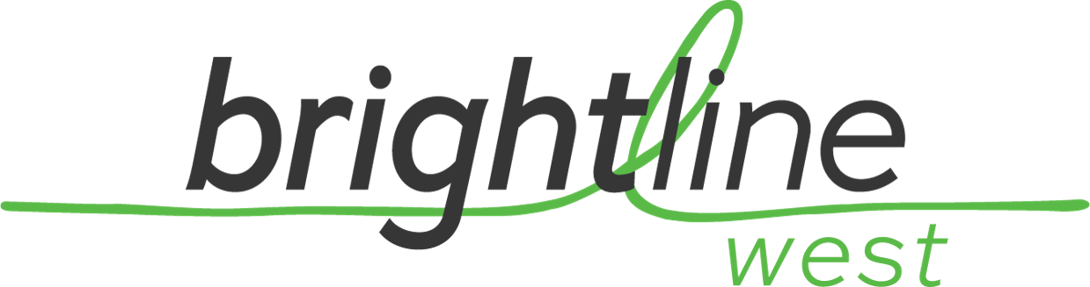
Federal Railroad Administration
NEPA, corridor safety, and rolling stock regulations
Surface Transportation Board
STB certification
Federal Highway Administration
NDOT & Caltrans
NEPA & agreements for ROW, D&C, and O&M
Railroads & Utilities
UPRR & BNSF, as well as utilities like SCE, LADWP, and NVE
Key Stakeholders
Fed-State Partnership Agreement
Bureau of Land Management
Land for CA substations and limited NV parcels including VMF
Apple Valley to Rancho Cucamonga
SBCTA, City of Rancho Cucamonga, and LAUS/Metrolink
+

Slide 10
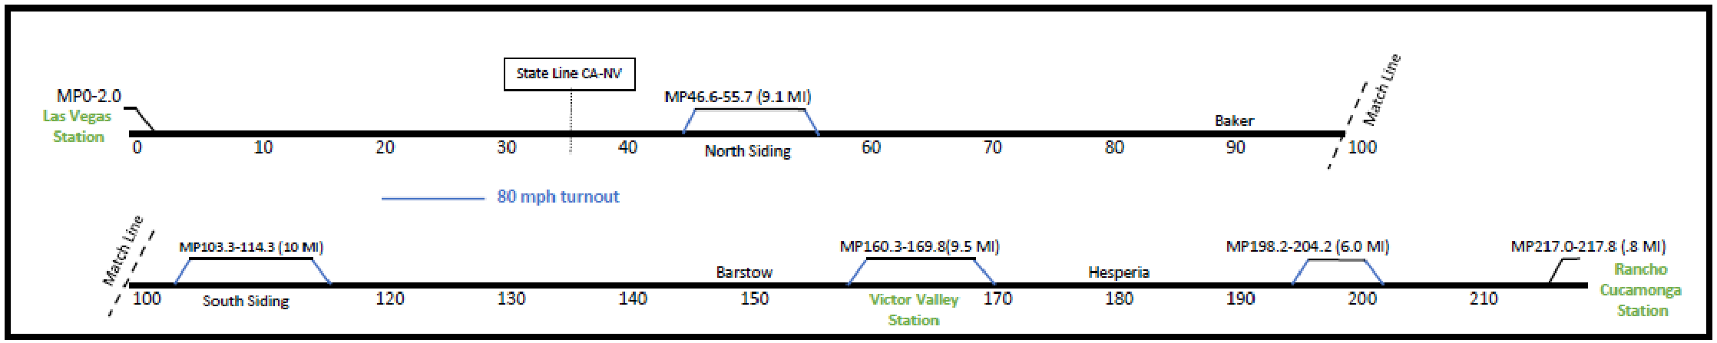
CONCEPT OF OPERATIONS - OVERVIEW
PRIMARILY SINGLE-TRACK RAILROAD WITH PASSING SIDINGS
60-minute Headways
Trip Time: ~2 hrs 10 min
Total Single-Track Miles | 180.4 | 83%
Total Double-Track Miles | 37.4 | 17%
Total Miles | 217.8 | 100%

Slide 11
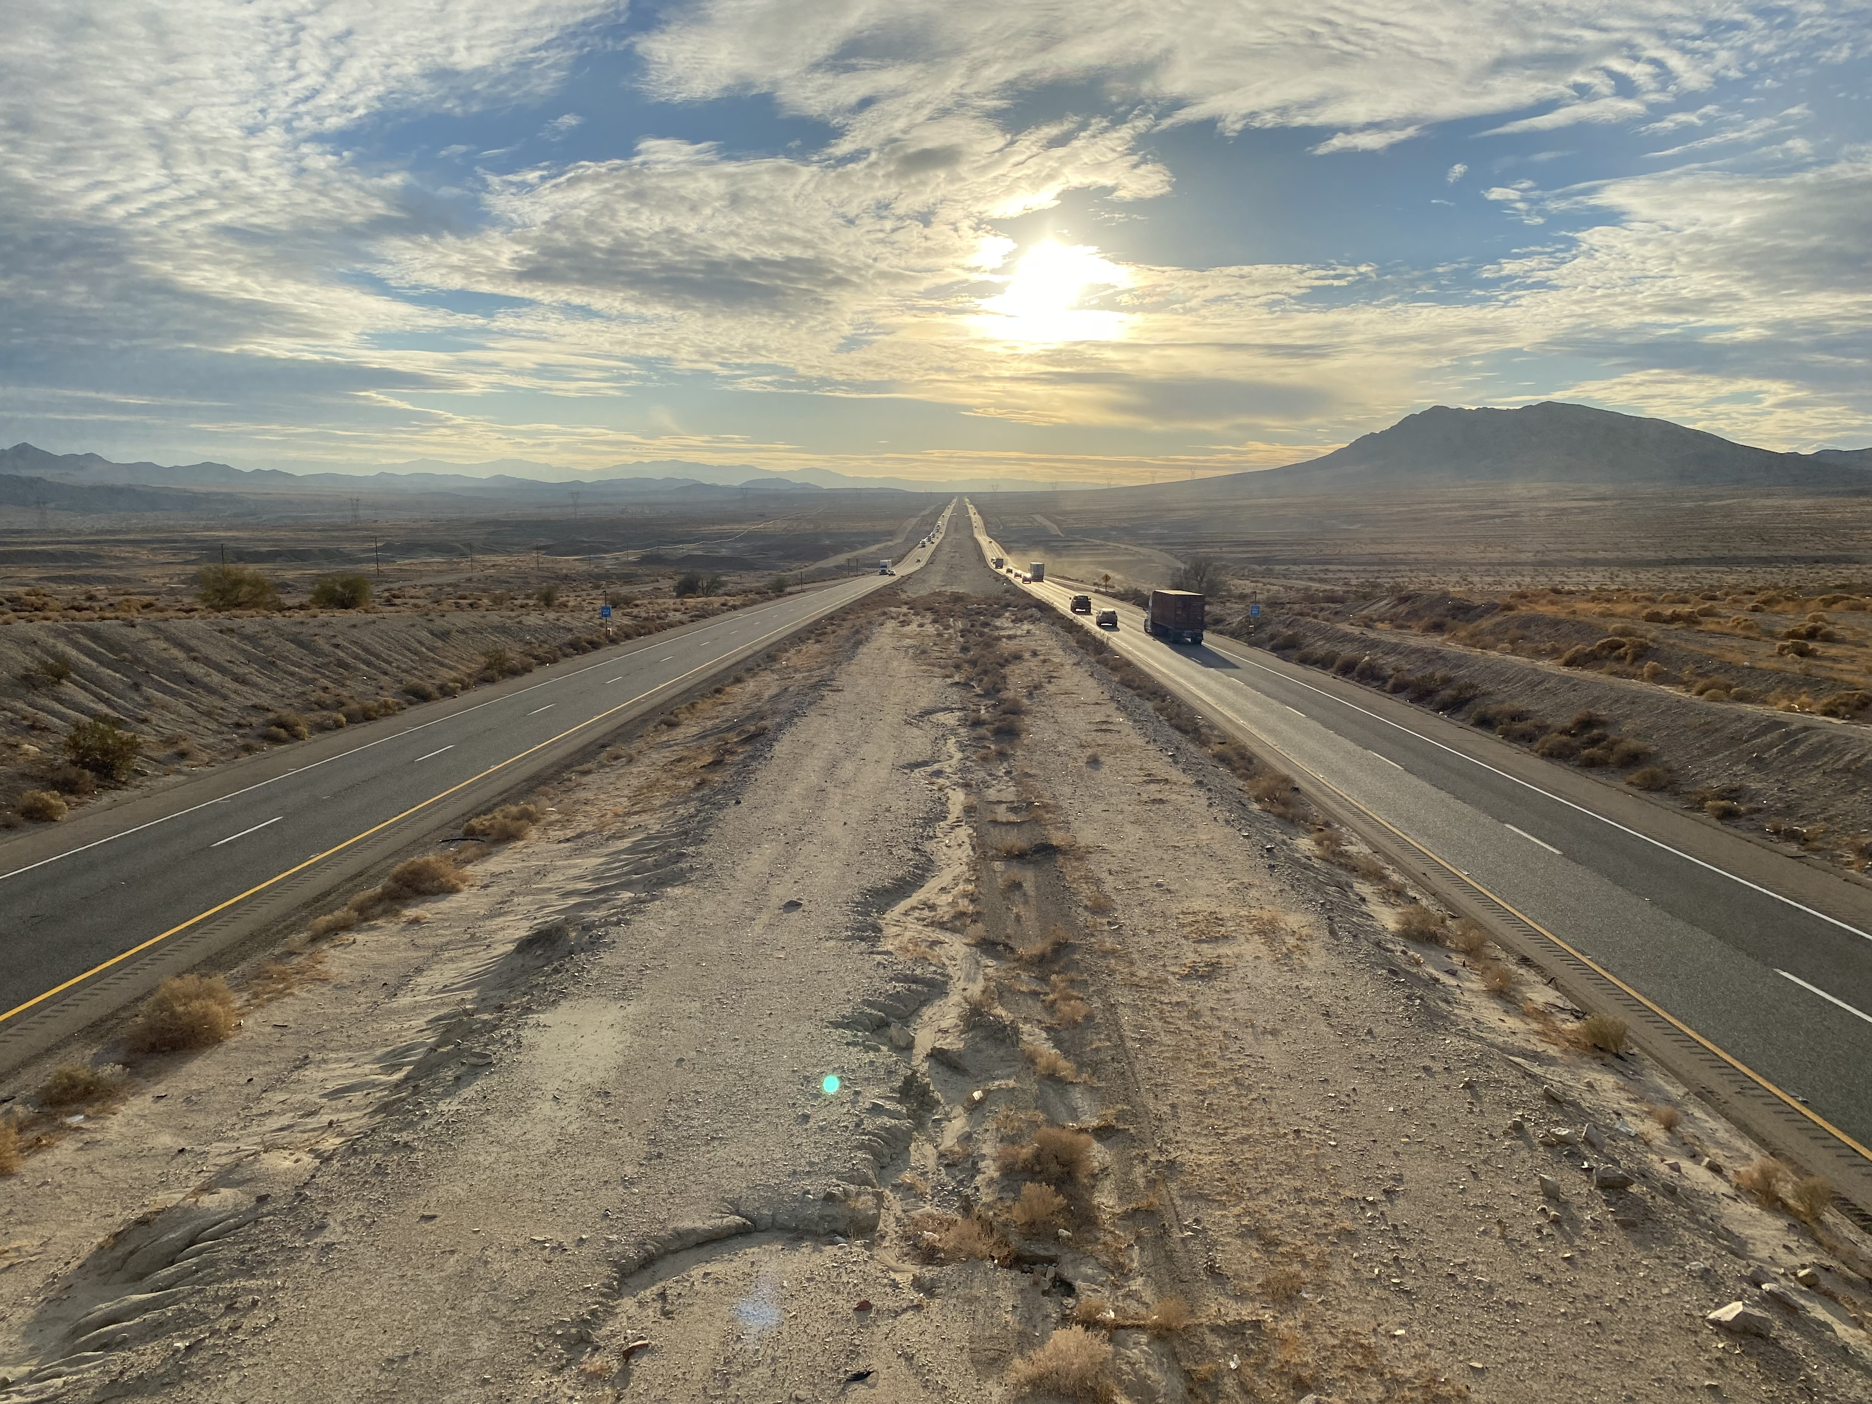
Unique Corridor – Topography, Environment, Highway
HSR corridor in median of highway
Desert and urban conditions

Slide 12
I-15 CORRIDOR PROFILE

Slide 13
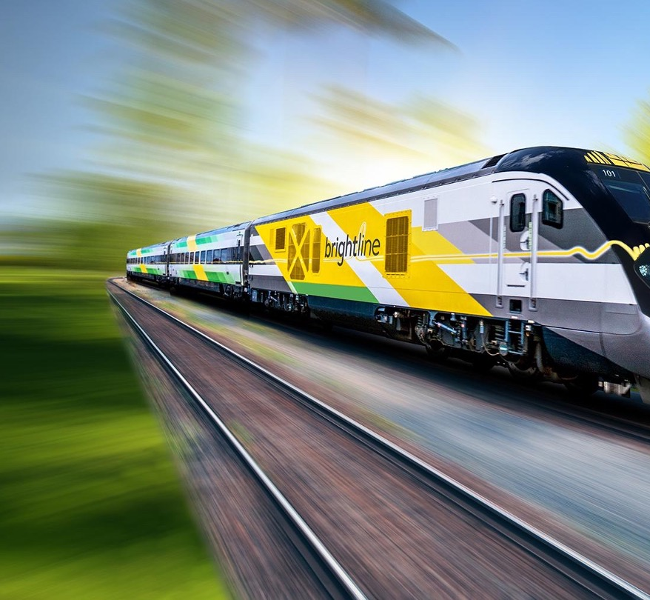
PROJECT DELIVERY APPROACH:
Civil Design-Build:
Split by geography into four contracts
Highway modifications, rail embankment, barrier interface
Rail corridor work includes up to sub-ballast
Track and Systems Design-Build:
Single project-wide contract - removes integration risk
Systems includes:
  European Train Control System (ETCS)
  25kV Power, and overhead catenary system
  Communications: train and passenger needs
Track: conventional 136#RE rail, concrete ties, ballast

Slide 14
PROJECT DELIVERY APPROACH:
Stations and Facilities Design-Build:
Individual contracts for terminal stations in LV and Rancho
Rancho Station includes 1-mile long viaduct connection to I-15
One contract for in-line stations, Vehicle Maintenance
Facility and Maintenance of Way buildings
Rolling Stock:
Siemens
Single Design-Build turnkey contract
Ten trainsets support initial service
LABOR AND WORKFORCE
MOU’s in place with labor unions
SBE and DBE through prime DB contractors

Slide 15
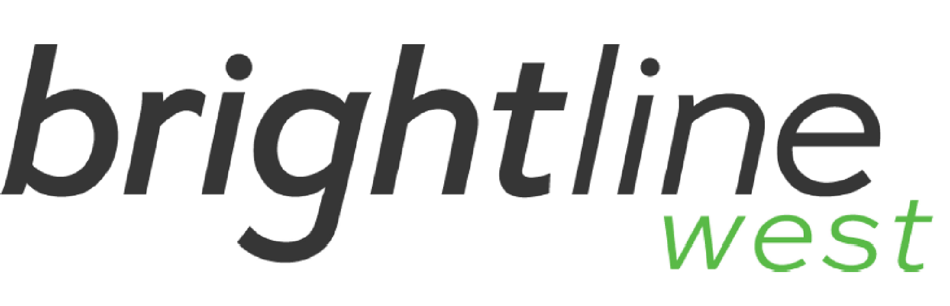
CONTRACT WORK ZONES
- 110 miles of rail work
- Longest civil construction package
- 39 miles of rail work
- 3800 ft Barstow Viaduct
- 34 miles of rail work
- 5% grade on Cajon Pass
- 34 miles of rail work
- St. Rose Pkwy Pergola Structure

Slide 16
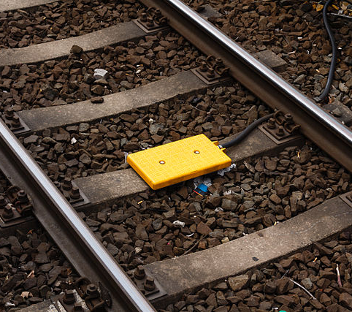
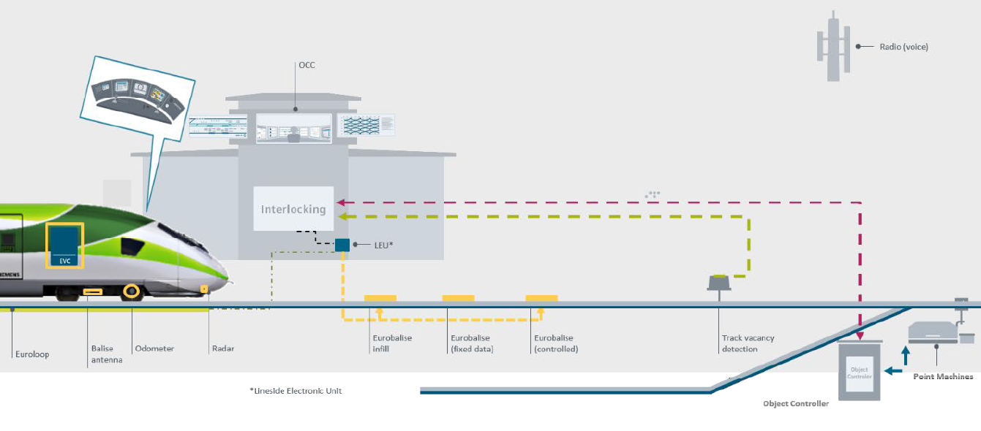
European Train Control System (ETCS)
Train Control (Signaling)

Slide 17
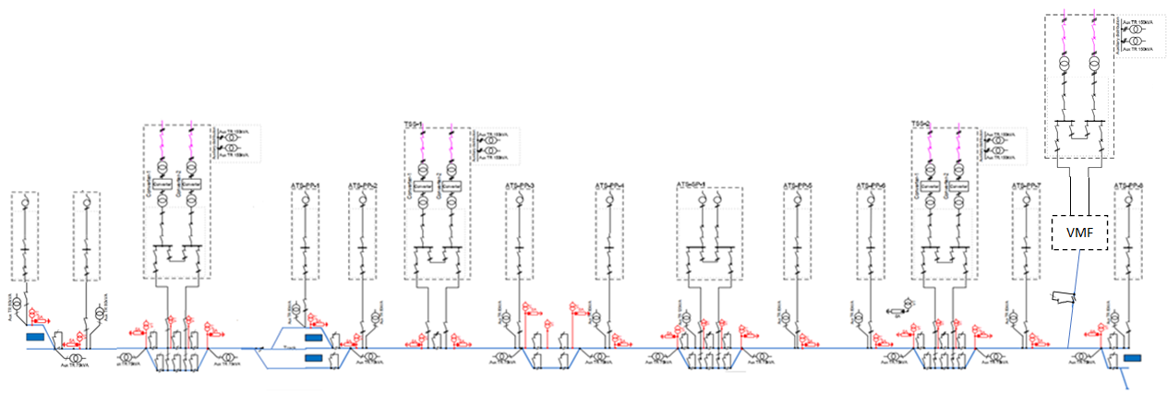
- Southern Cal Edison is building three dedicated ~60 MW capacity substations for BLW
- Nevada Energy to provide power from existing substation for Vehicle Maintenance Facility
POWER SUPPLY
VMF
Tortilla Kramer
Hesperia
Ivanpah
Rancho
Victorville
Las Vegas
Feed in Sites – Location of Traction power substations
ATS Sites – Voltage boosting to maintain Traction power voltage

Slide 18
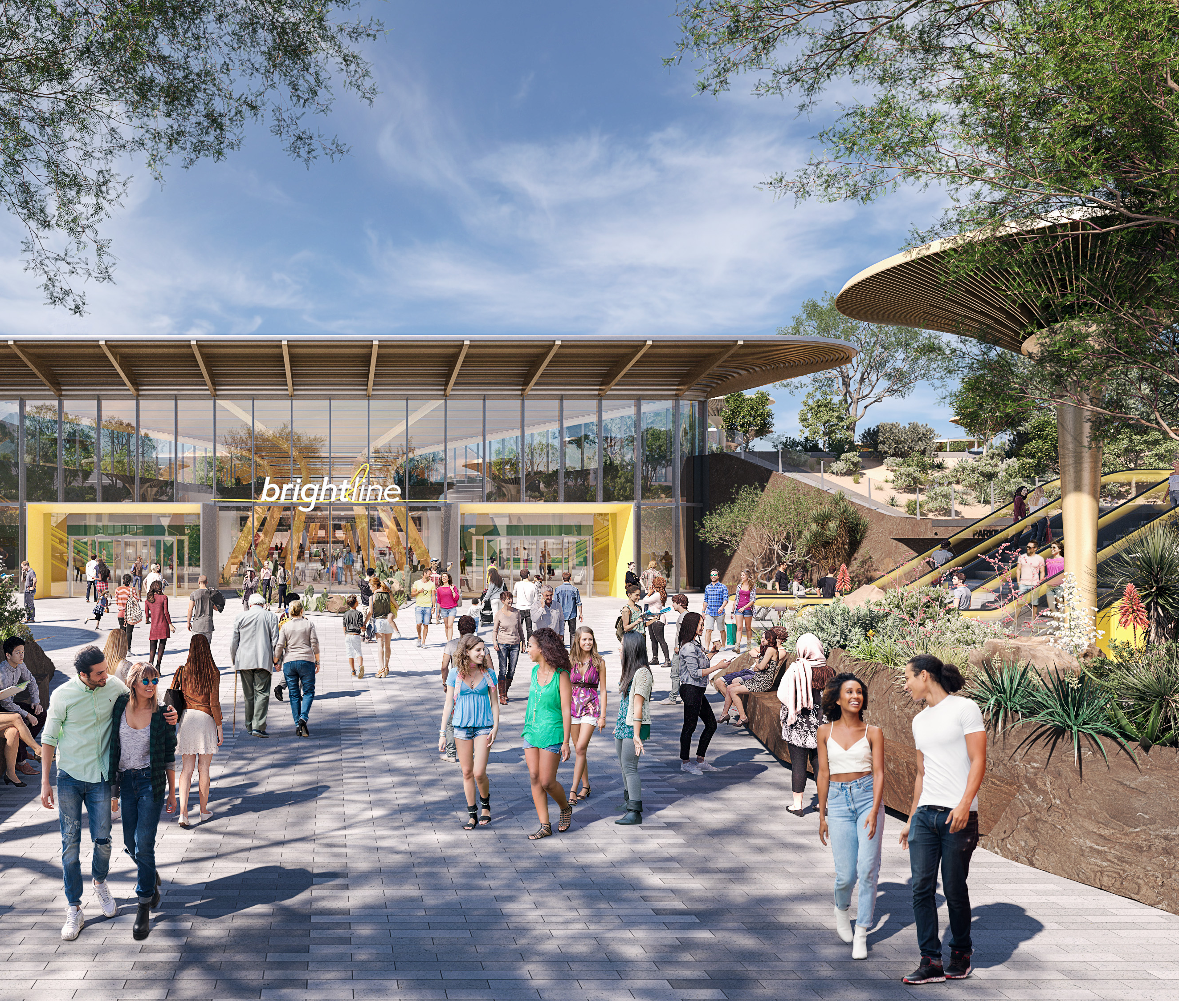
LAS VEGAS
STATION
Brightline Trains owns 110 acres on Las Vegas Blvd.
Proximate to major Las Vegas hotels, casinos, sports stadiums, and convention center
Adjacent to I-15 & I-215 / One mile from major international airport
Centrally located in Las Vegas’ most actively developed region

Slide 19
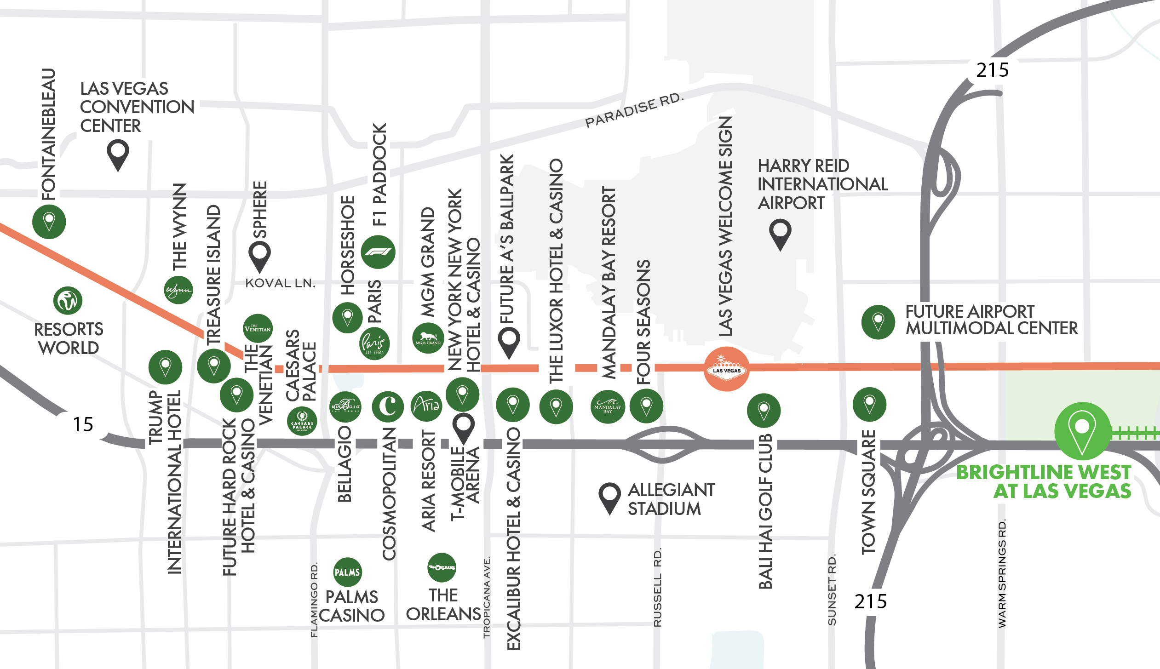

Slide 20
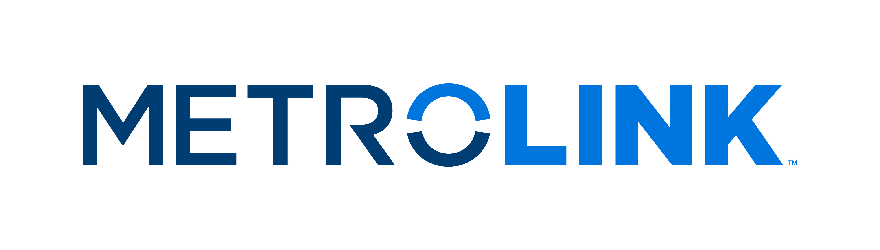
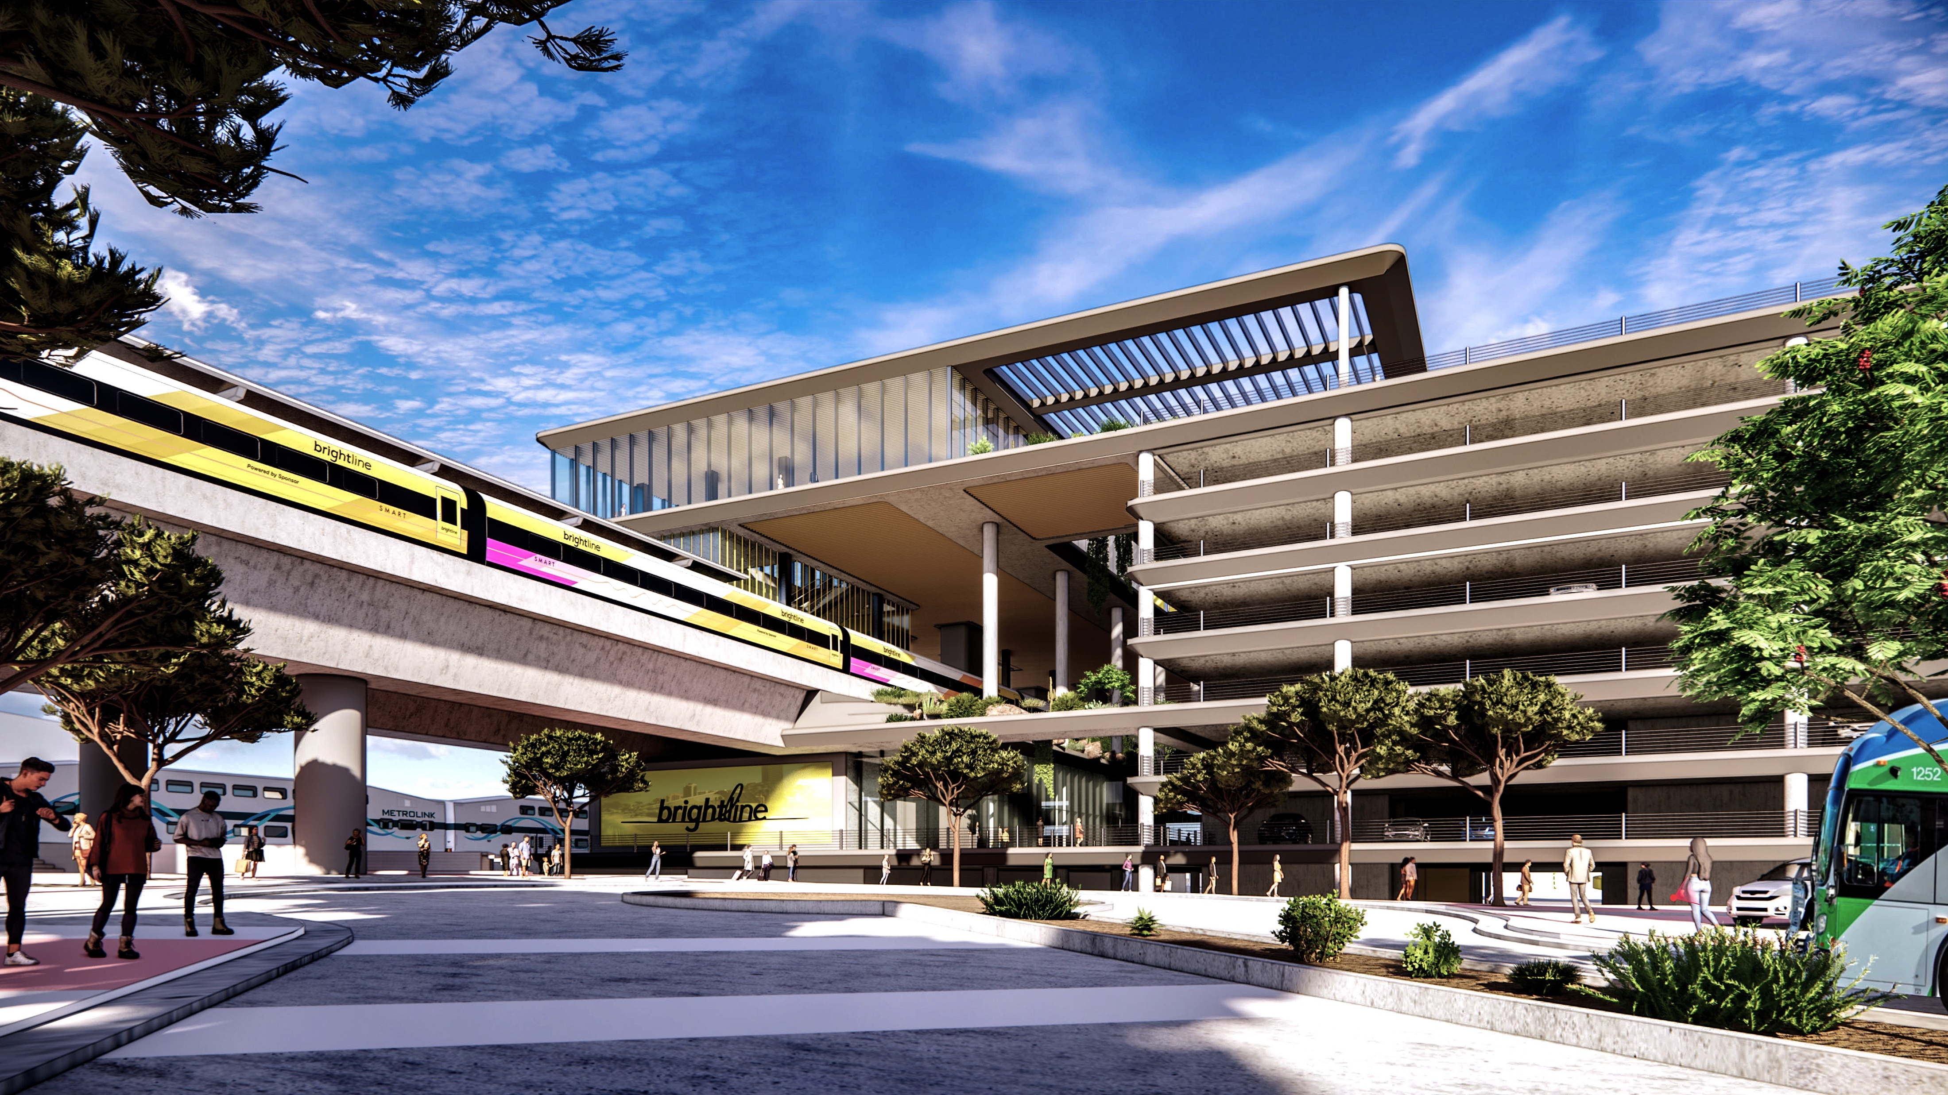
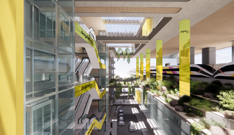
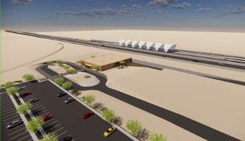
CALIFORNIA STATIONS
COORDINATION WITH METROLINK
TIMETABLE SCHEDULING
SEAMLESS TRANSFERS
TICKETING
BRANDING
RANCHO CUCAMONGA STATION
VICTOR VALLEY (similar Hesperia)
IN-LINE STATION

Slide 21
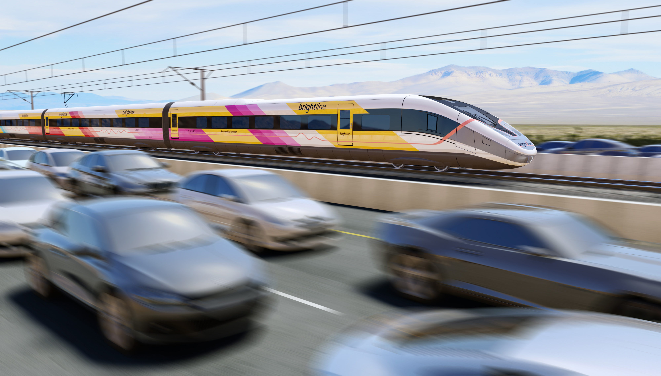
SIEMENS AMERICAN PIONEER 220
ROLLING STOCK
Fully electric-powered trains capable of 200+ mph
Approx. 430 passengers per train
Trains can be coupled to double capacity
Initial order of 10 trainsets
Interoperable with CAHSR

Slide 22
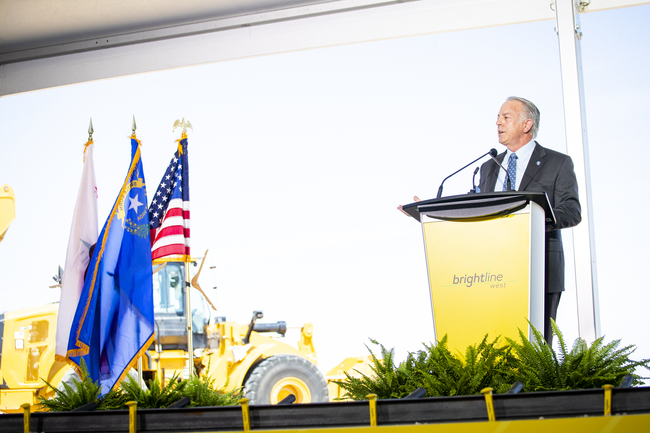
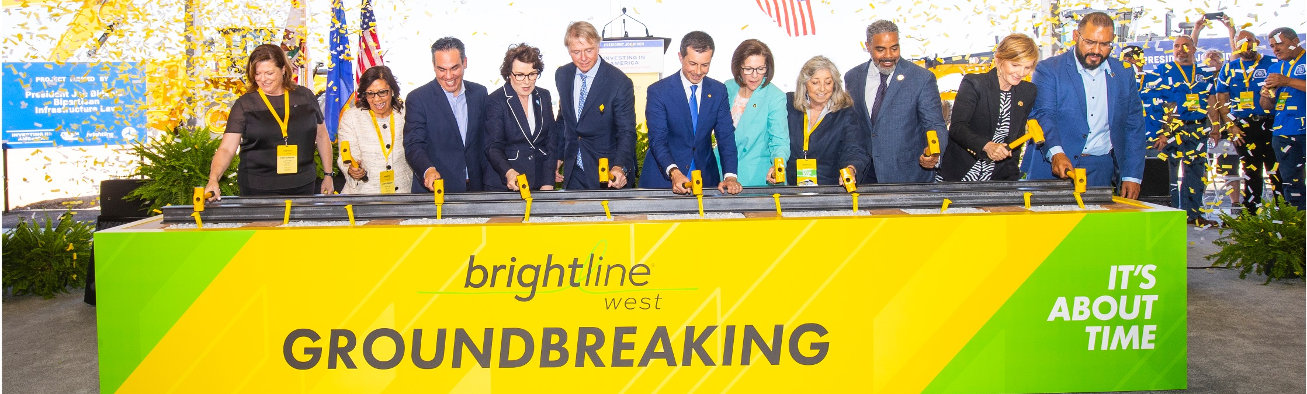
Latest Timeline of Events
May 2024: Siemens Selected as Rolling Stock Manufacturer
Sept 2024: Siemens Announces New York Facility
Sept 2024: $3B FSP Grant Agreement Signed
March 2025: $2.5 B PAB’S issued
Current: Finalizing contracts with DB teams

Slide 23

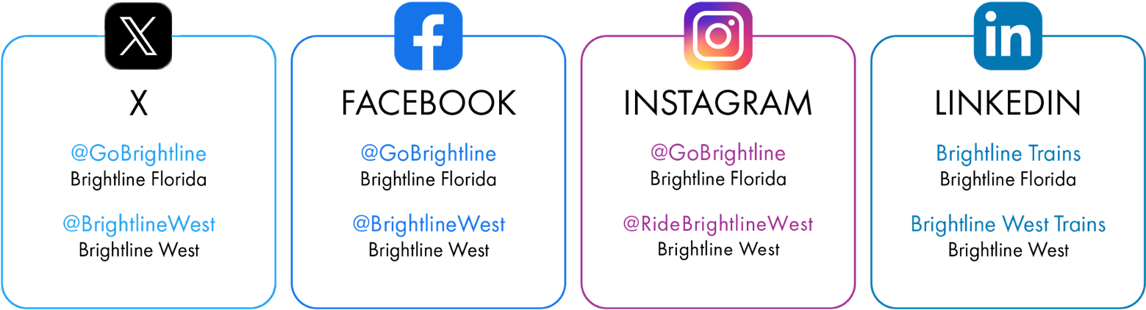
CONTACT US
Media Inquiries
Ben Porritt
ben@gobrightline.com
Antonio Castelan acastelan@brightlinewest.com
Government Affairs
Asha Jones
ajones@brightlinewest.com
FOLLOW US

Slide 24
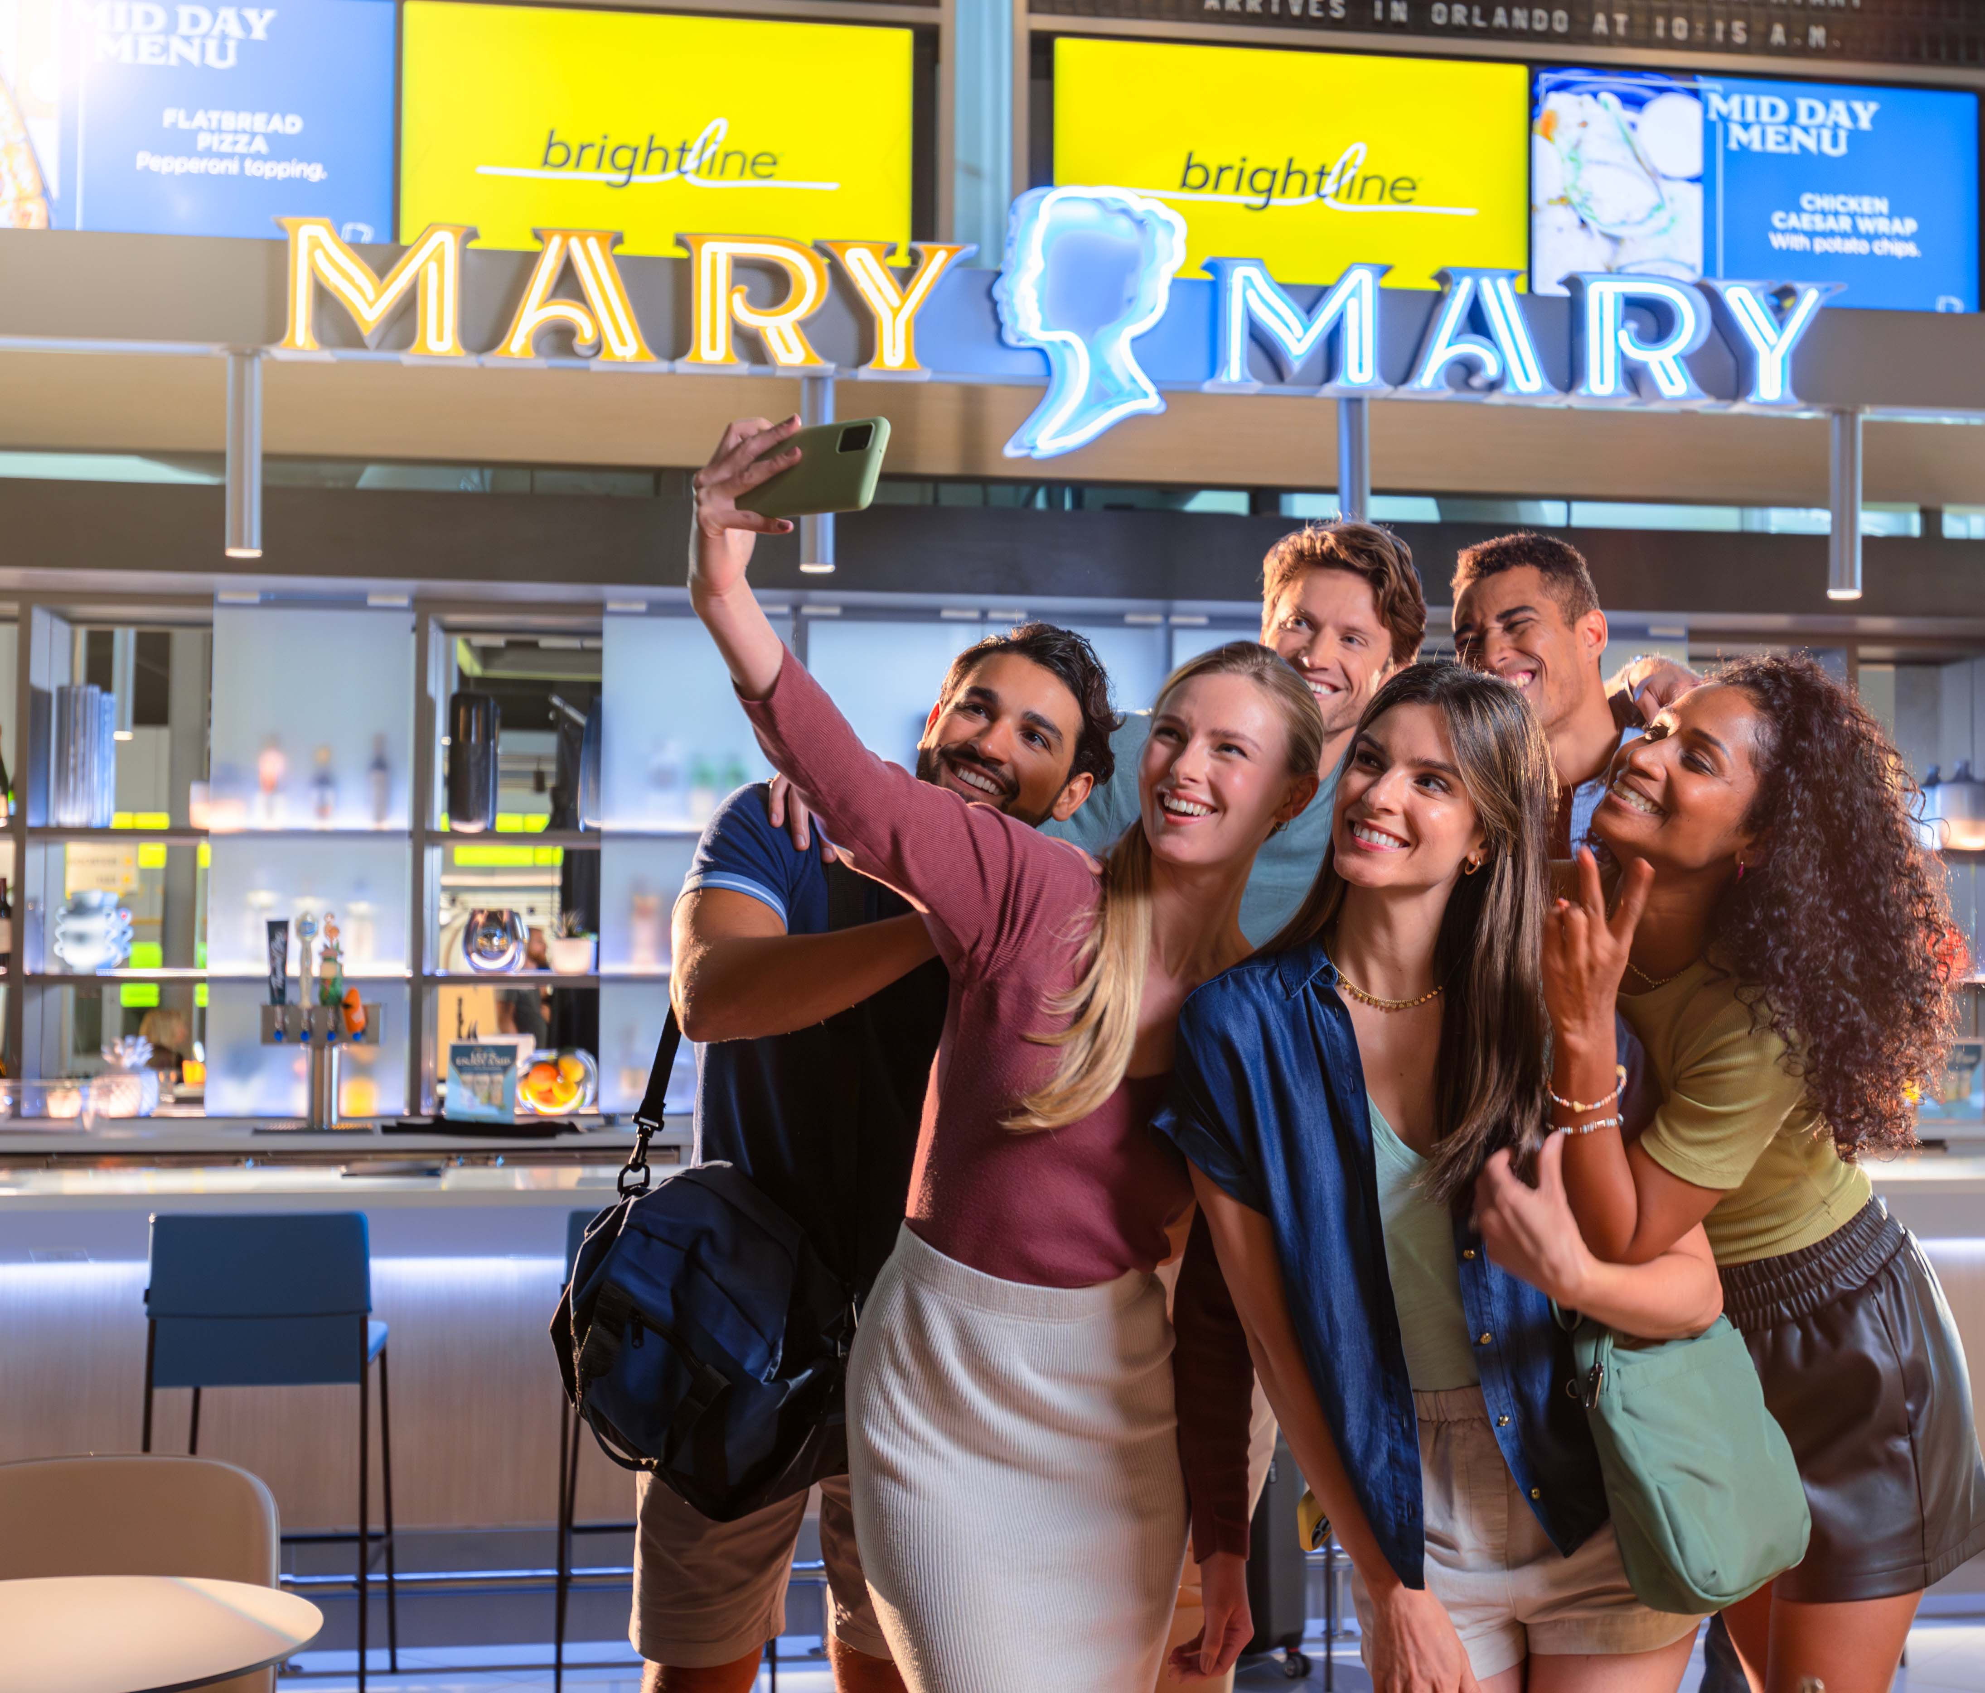
THANK YOU!

